Slide 1
Runtime Analysis and Growth of Functions

Slide 2
Analysis of algorithms
Issues:
correctness
time efficiency
space efficiency
optimality
Approaches:
theoretical analysis
empirical analysis

Slide 3
Efficiency
Correctness alone is not enough
For any problem, there is always a brute-force algorithm
Enumerate all possibilities
Verify which one is correct
Often Too slow
Takes too much space if you compare all of them at the same time
Time efficiency (complexity)
Space efficiency (complexity)

Slide 4
How to measure complexity?
Accurate execution time is not a good measure
It depends on input
It depends on the machine you used and who implemented the algorithm
It depends on the weather, maybe
We would like to have an analysis that does not depend on those factors

Slide 5
Machine-independent
A generic uniprocessor random-access machine (RAM) model
No concurrent operations
Each simple operation (+, -, =, if) takes 1 step (constant).
Loops and subroutine calls are not simple operations.
All memory equally expensive to access
Constant word size

Slide 6
Running Time
Number of primitive steps that are executed
Except for time of executing a function call most statements roughly require the same amount of time
y = m * x + b
c = 5 / 9 * (t - 32 )
We can be more exact if need be

Slide 7
Asymptotic Analysis
Running time depends on the size of the input
Larger array takes more time to sort
T(n): the time taken on input with size n
Look at growth of T(n) as n→∞.
“Asymptotic Analysis”
Size of input is generally defined as the number of input elements
In some cases may be tricky

Slide 8
Asymptotic Analysis
Ignore actual and abstract statement costs
Order of growth is the interesting measure:
Highest-order term is what counts
As the input size grows larger it is the high order term that dominates

Slide 9
Theoretical analysis of time efficiency
Time efficiency is analyzed by determining the number of repetitions of the basic operation as a function of input size
Basic operation: the operation that contributes most towards the running time of the algorithm
T(n) ≈ c_{op}C(n)
input size
running time
execution time
for basic operation
Number of times basic operation is executed

Slide 10
Input size and basic operation examples
Problem | Input size measure | Basic operation
Searching for key in a list of n items | Number of list’s items, i.e. n | Key comparison
Multiplication of two matrices | Matrix dimensions or total number of elements | Multiplication of two numbers
Checking primality of a given integer n | n’size = number of digits (in binary representation) | Division
Typical graph problem | #vertices and/or edges | Visiting a vertex or traversing an edge

Slide 11
Empirical analysis of time efficiency
Select a specific (typical) sample of inputs
Use physical unit of time (e.g., milliseconds)
or
Count actual number of basic operation’s executions
Analyze the empirical data

Slide 12
Best-case, average-case, worst-case
For some algorithms’ efficiency depends on form of input:
Worst case: C_{worst}(n) – maximum over inputs of size n
Best case: C_{best}(n) – minimum over inputs of size n
Average case: C_{avg}(n) – “average” over inputs of size n
Number of times the basic operation will be executed on typical input
NOT the average of worst and best case
Expected number of basic operations considered as a random variable under some assumption about the probability distribution of all possible inputs

Slide 13
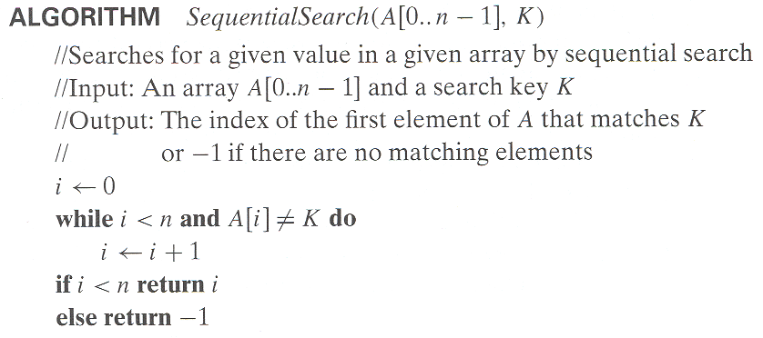
Example: Sequential search
Worst case
Best case
Average case

Slide 14
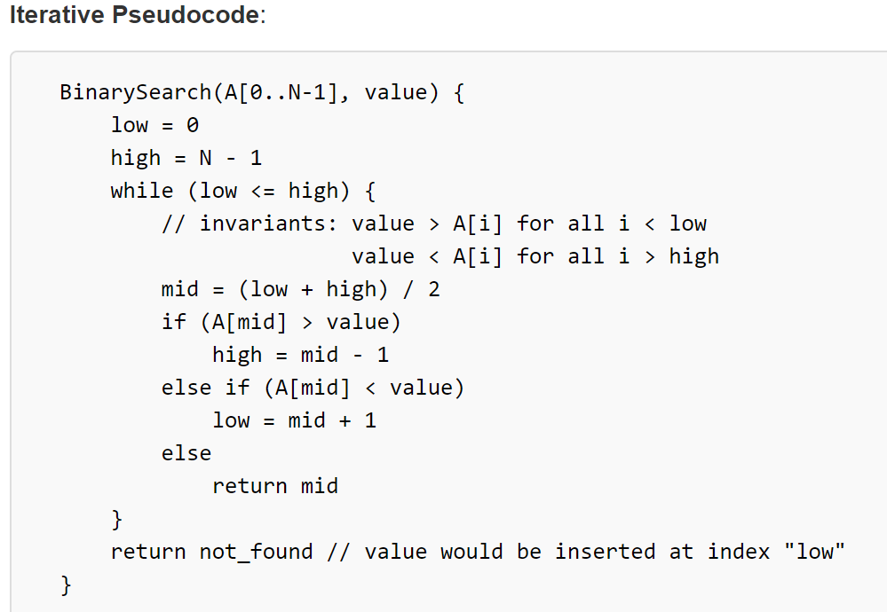
Binary Search

Slide 15
Order of growth
Most important: Order of growth within a constant multiple as n→∞
Example:
How much faster will algorithm run on computer that is twice as fast?
Two times faster
How much longer does it take to solve problem of double input size?
Depends on Big-O of algorithm or order of running time
O(n²) will take four times longer
O(n) will take 2 times longer
Notes:
Example: cn²
how much faster on twice as fast computer? (2)
how much longer for 2n? (4)

Slide 16
Order of growth
1 << log₂n << n << nlog₂n << n² << n³ << 2^{n} << n!
(We are slightly abusing of the “<<“ sign. It means a smaller order of growth).

Slide 17
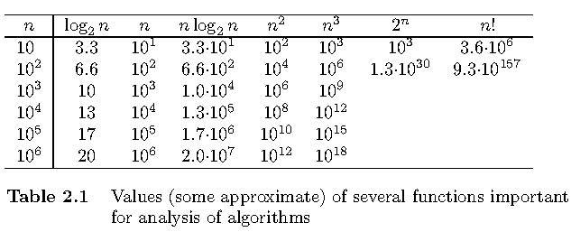
Values of some important functions as n → ∞

Slide 18
Asymptotic notations
O: Big-Oh
Ω: Big-Omega
Θ: Theta

Slide 19
Big O
Informally, O (g(n)) is the set of all functions with a smaller or same order of growth as g(n), within a constant multiple
What is O(n²)?
The set of all functions that grow slower than or in the same order as n²

Slide 20
Examples
So:
n ∈ O(n²)
n² ∈ O(n²)
1000n ∈ O(n²)
n² + n ∈ O(n²)
100n² + n ∈ O(n²)
But:
1/1000 n³ ∉ O(n²)
Intuitively, O is like ≤

Slide 21
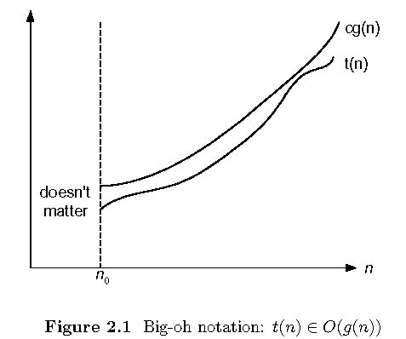
Big-oh

Slide 22
Big Ω
Informally, Ω (g(n)) is the set of all functions with a larger or same order of growth as g(n), within a constant multiple
So:
n² ∈ Ω(n)
1/1000 n² ∈ Ω(n)
But:
1000 n ∉ Ω(n²)
Intuitively, Ω is like ≥

Slide 23
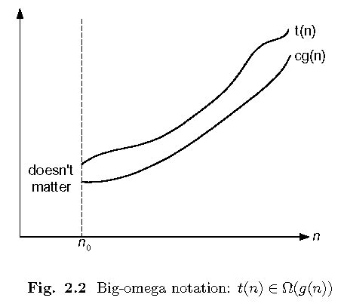
Big-omega

Slide 24
Big-Omega
Math:
Ω(g(n)) = {f(n): ∃ positive constants c and n₀ such that cg(n) ≤ f(n) ∀ n ≥ n₀}
Or: lim _{n→∞} f(n)/g(n) =∞ (if the limit exists.)
Engineering:
g(n) is an asymptotic lower bound of f(n)
Intuitively it is like f(n) ≥ g(n)
For convenience:
f(n) = Ω(g(n)) actually means f(n) ∈ Ω(g(n))

Slide 25
Theta (Θ)
Informally, O (g(n)) is the set of all functions with the same order of growth as g(n), within a constant multiple
What is Θ(n²)?
The set of all functions that grow in same order as n²

Slide 26
So:
n² ∈ Θ(n²)
n² + n ∈ Θ(n²)
100n² + n ∈ Θ(n²)
100n² + log₂n ∈ Θ(n²)
But:
nlog₂n ∉ Θ(n²)
1000n ∉ Θ(n²)
1/1000 n³ ∉ Θ(n²)
Intuitively, Θ is like =

Slide 27
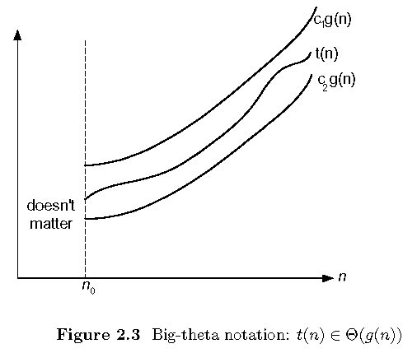
Big-theta

Slide 28
Theta
Math:
Θ(g(n)) = {f(n): ∃ positive constants c₁, c₂, and n₀ such that c₁ g(n) ≤ f(n) ≤ c₂ g(n) ∀ n ≥ n₀ }
Or: lim _{n→∞} f(n)/g(n) = c > 0 and c < ∞
Or: f(n) = O(g(n)) and f(n) = Ω(g(n))
Engineering:
g(n) is an asymptotically tight bound of f(n)
Intuitively it is like f(n) = g(n)
For convenience:
f(n) = Θ(g(n)) actually means f(n) ∈ Θ(g(n))
Θ(1) means constant time.

Slide 29
Asymptotic order of growth
A way of comparing functions that ignores constant factors and small input sizes
O(g(n)): class of functions f(n) that grow no faster than g(n)
Θ(g(n)): class of functions f(n) that grow at same rate as g(n)
Ω(g(n)): class of functions f(n) that grow at least as fast as g(n)

Slide 30
Types of formulas for basic operation’s count
Exact formula
e.g., C(n) = n(n-1)/2
Formula indicating order of growth with specific multiplicative constant
e.g., C(n) ≈ 0.5 n²
Formula indicating order of growth with unknown multiplicative constant
e.g., C(n) ≈ cn²

Slide 31
Establishing order of growth using the definition
Definition: f(n) is in O(g(n)) if order of growth of f(n) ≤ order of growth of g(n) (within constant multiple), i.e., there exist positive constant c and non-negative integer n₀ such that
f(n) ≤ c g(n) for every n ≥ n₀
Examples:
10n is O(n²)
5n+20 is O(n)
Notes:
Examples:
10n is O(n²)
since 10n ≤ 10n² for n ≥ 1 or 10n ≤ n² for n ≥ 10
c n₀
5n+20 is O(10n)
since 5n+20 ≤ 10 n for n ≥ 4
c n₀

Slide 32
Some properties of asymptotic order of growth
f(n) ∈ O(f(n))
f(n) ∈ O(g(n)) iff g(n) ∈Ω(f(n))
If f (n) ∈ O(g (n)) and g(n) ∈ O(h(n)) , then f(n) ∈ O(h(n)) Note similarity with a ≤ b
If f₁(n) ∈ O(g₁(n)) and f₂(n) ∈ O(g₂(n)) , then
f₁(n) + f₂(n) ∈ O(max{g₁(n), g₂(n)})

Slide 33
Rule 1 Adding Two Functions
f₁(n) ∈ O(g₁(n)) and f₂ (n) ∈ O(g₂(n))
=> f₁(n) + f₂ (n) ∈ O(max{g₁(n), g₂(n)})
Here max compares the asymptotic order
For example: n² + n ∈ O(n²)

Slide 34
Rule 2 Multiplying Functions
f₁(n) ∈ O(g₁(n)) and f₂ (n) ∈ O(g₂(n))
f₁(n) * f₂ (n) ∈ O(g₁(n) * g₂(n))
For example:
(n² + n) (n + log₂n) ∈ O(n³)

Slide 35
Base of Logs
Compare log₂n and log₁₀n
Definition: log_{a}b = log_{c}b / log_{c}a
So: log₂n = log₁₀n / log₁₀2 ~ 3.3 log₁₀n
Log₂n = Θ (log₁₀n)

Slide 36
Using limits for comparing orders of growth
0
lim f(n) / g(n) = c > 0
∞
f(n) has smaller order of growth than g(n)
f(n) and g(n) have same order
n→∞
f(n) has larger order of growth than g(n)

Slide 37
L’Hôpital’s rule and Stirling’s formula
L’Hôpital’s rule: If lim_{n→∞} f(n) = lim_{n→∞} g(n) = ∞ and
the derivatives f´, g´ exist, then
Stirling’s formula: n! ≈ (2πn)^{1/2} (n/e)^{n}
f(n)
g(n)
f ´(n)
g ´(n)
lim
n→∞
=
lim
n→∞
Example: log n vs. n
Example: 2^{n} vs. n!

Slide 38
Exponential Growth
Compare 2^{n} and 3^{n}
lim 2^{n} / 3^{n} = lim(2/3)^{n} = 0
Therefore, 2^{n} ∈ O(3^{n}), and 3^{n} ∈ Ω(2^{n})
n→∞
n→∞

Slide 39
Orders of growth of some important functions
All logarithmic functions log_{a} n belong to the same class no matter what the logarithm’s base a > 1 is
Θ(log n)
All polynomials of the same degree k belong to the same class:
a_{k}n^{k} + a_{k-1}n^{k-1} + … + a₀ ∈ Θ(n^{k})
Exponential functions a^{n} have different orders of growth for different a’s
order log n < order n^{α} (α>0) < order a^{n} < order n! < order n^{n}

Slide 40
Basic asymptotic efficiency class names
1 | constant
log n | logarithmic
n | linear
n log n | n-log-n or linearithmic
n² | quadratic
n³ | cubic
2^{n} | exponential
n! | factorial

Slide 41
Time efficiency of nonrecursive algorithms
General Plan for Analysis
Decide on parameter n indicating input size
Identify algorithm’s basic operation
Determine worst, average, and best cases for input of size n
Set up a sum for the number of times the basic operation is executed
Simplify the sum using standard formulas and rules

Slide 42
Useful summation formulas and rules
Σ_{l≤i≤u}1 = 1+1+ ⋯ +1 = u - l + 1
In particular, Σ_{l≤i≤u}1 = n - l + 1 = n ∈ Θ(n)
Σ_{1≤i≤n} i = 1+2+ ⋯ +n = n(n+1)/2 ≈ n²/2 ∈ Θ(n²)
Σ_{1≤i≤n} i² = 1²+2²+ ⋯ +n² = n(n+1)(2n+1)/6 ≈ n³/3 ∈ Θ(n³)
Σ_{0≤i≤n} a^{i} = 1 + a + ⋯ + a^{n} = (a^{n+1} - 1)/(a - 1) for any a ≠ 1
In particular, Σ_{0≤i≤n} 2^{i} = 2⁰ + 2¹ + ⋯ + 2^{n} = 2^{n+1} - 1 ∈ Θ(2^{n} )
Σ(a_{i} ± b_{i} ) = Σa_{i} ± Σb_{i} Σca_{i} = cΣa_{i} Σ_{l≤i≤u}a_{i} = Σ_{l≤i≤m}a_{i} + Σ_{m+1≤i≤u}a_{i}

Slide 43
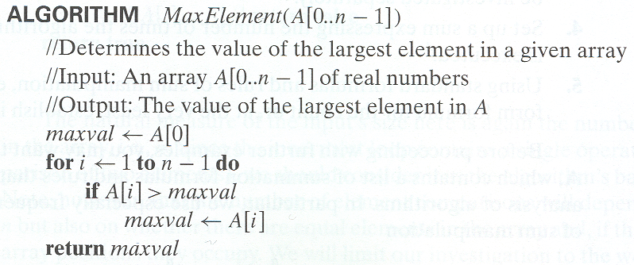
Example 1: Maximum element

Slide 44
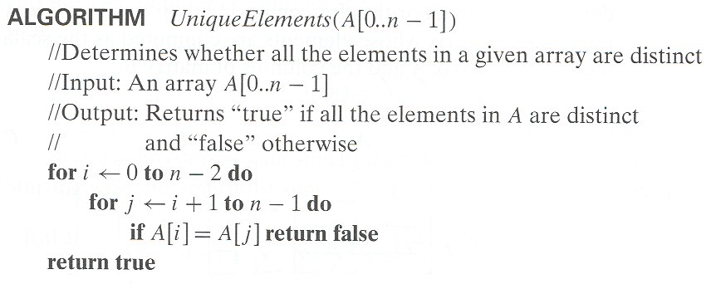
Example 2: Element uniqueness problem

Slide 45
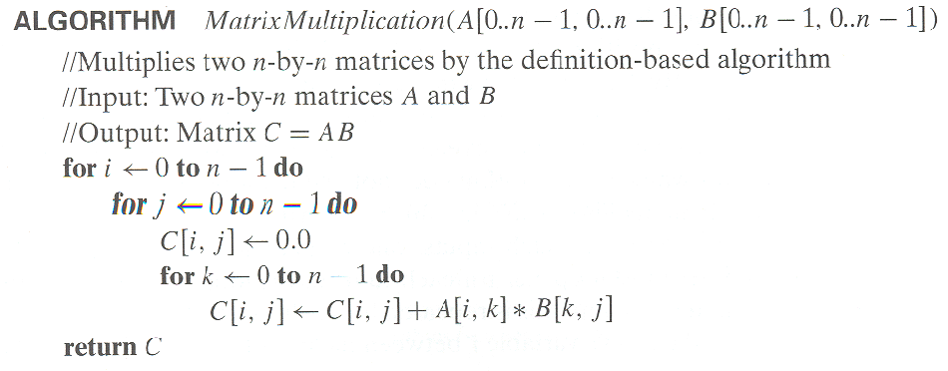
Example 3: Matrix multiplication

